Slide 1
Chronic Kidney Disease (CKD) & End Stage Renal Disease (ESRD)
Review of Renal Function
Evaluation of Renal Function
Definition of CKD
Stages of CKD
Etiology
Epidemiology
Pathophysiology of Progression of Renal Disease
Prognosis
Causes of Death in ESRD Patients
Prevention of CKD
Therapeutic Goals & Pharmacotherapy to Prevent Progression of CKD
Review of Systems Affected by CKD
Anemia of CKD
Secondary Hyperparathyroidism (PTH, Calcium, Vit D feedback)
Hyperkalemia
Metabolic Acidosis
Vitamin Replacement

Slide 2
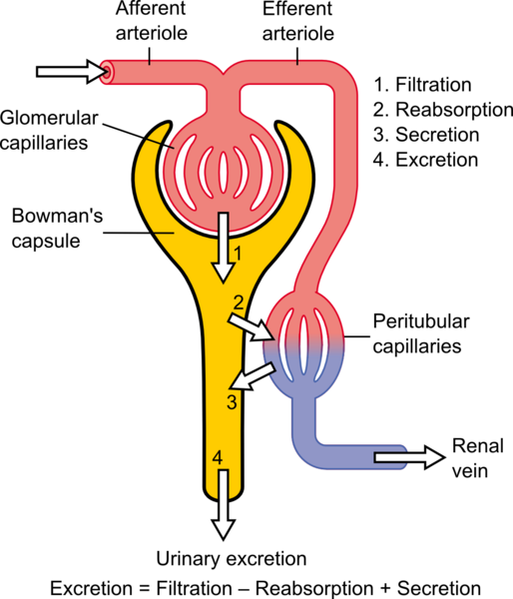
Review of Renal Function
Excretory function: Filtration – Secretion – Tub Reab
GFR = (F + S – R) [the best test for level of kidney function & stage of kidney disease]
CrCl – approximating the GFR
GFR scale: … 15 – 30 – 60 – 90 …
F S Mo Mi N
Metabolic function:
D3↓ … hypoCa … 2º hyperPTH … osteodystrophy
Insulin↑ … hypoglycemia
Endocrine function:
Renin↑ … hypertension
Erythropoietin↓ … chronic anemia

Slide 3
Evaluation of Renal Function
Glomerular filtration rate (GFR) – Equations
By 24hr urine collection
Cockcroft-Gault (CrCl ml/min) for dose adjustment
MDRD4 (ml/min/1.73m2) for staging patients
Protein Excretion Measurement:
Qualitative by colorimetric rx (shade of green)
Scale: Neg …. 10 – 30 – 100 – 300 …
T 1+ 2+ 3+ 4+
Dipsticks: False positive and False negative
Quantitative by proteine:creatinine ratio method = g prot/day
Scale: ……….. 30 …………………………300mg/d …………………..
Norm Micro-album Macro-album
Who to screen for proteinuria?
Children for congenital abnormalities
Adults:
Clinical: diabetes, HTN, autoimmune, chronic UTI
Socioeconomic: age >60, ethnic minority status

Slide 4
Definition of CKD
CKD is defined as:
Structural – pathophysiological change with blood or protein in urine OR
Functional – reduction in GFR < 60 ml/min/1.73 m2
Damage to the kidneys for at least 3 months
Organizations & Foundations:
NKF – K/DOQI: guidelines for the basis for continuous care & therapy throughout CKD – Group that developed the CKD classification system – for TX of pts on dialysis
KDIGO: to improve the care & outcomes of CKD thru promoting coordination, collaboration and integration of initiatives to develop and implement clinical practices guidelines – for TX of pts before or delay dialysis

Slide 5
Stages of CKD
By MDRD4 equation – K/DOQI guidelines
Stage | Description | GFR (ml/min/1.73m²) | Detection, Evaluation and Management | No. of cases (millions)
1 | Kidney damage with normal or ↑ GFR | >90 ml/min | Diagnosis and treat to slow progression | 3.6 (1.8% US population)
2 | Kidney damage with mild ↓ GFR | 60-90 ml/min | Estimate progression | 6.5
3 | Moderate ↓ GFR | 30-60 ml/min | Evaluate and treat complications | 15.5 (7.7% US population)
4 | Severe ↓ GFR | 15-30 ml/min | Referral to nephrologist and consideration for renal replacement therapy | 0.7
5 | Kidney Failure (ESRD) | <15ml/min | Renal replacement therapy | 0.5*

Slide 6
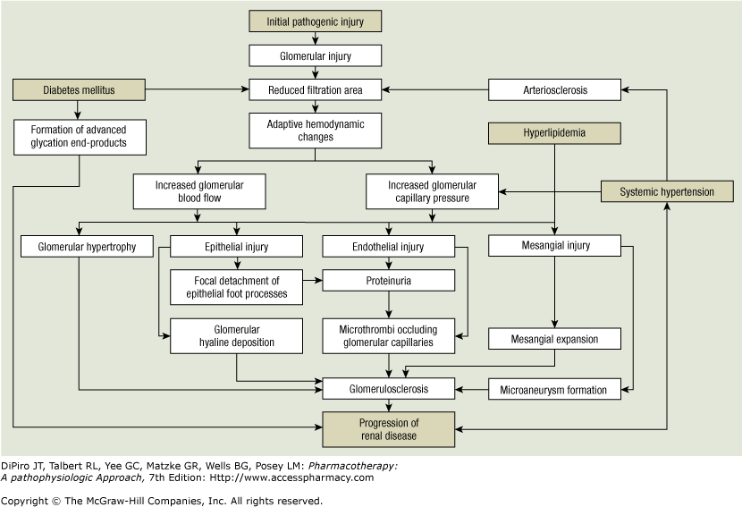
Pathophysiology of Progression of Renal Disease

Slide 7
Prognosis
Loss of renal function typically proceeds slowly and is irreversible
Normal loss of GFR with aging is 0.5-1.0 ml/minute/year
Presence of microalbuminuria is a high prognostic factor for cardiovascular disease
Long-term prognosis depends not only on controlling the rate of progression of kidney disease but also on controlling cardiovascular risk factors

Slide 8
Causes of Death in ESRD Patients
Left ventricular hypertrophy due to many years of fluid retention)
Infection 15% due to dialysis procedure
cerebrovascular disease 6% - strokes

Slide 9
Prevention of CKD
Reduce proteinuria
Control blood pressure
Intensive blood glucose control
Treat hyperlipidemia
Lifestyle modifications
Micro-albuminuria is the strongest independent predictor for developing ESRD
Micro-albuminuria is an independent risk factor for CV morbidity and mortality

Slide 10
Therapeutic Goals & Pharmacotherapy to Prevent Progression of CKD
Systemic Hypertension is independent of diabetes status
To Reduce BP to control albuminuria
ACE-Inhibitors (catopril, enalapril, benazepril, ramipril)
Angiotensin II Receptor Blockers (losartan, irbesartan, valsartan)
Calcium Channel Blockers – non-dihydropyridines (diltiazem, verapamil)
Diuretics (HCTZ)
Beta-Blockers
Combination Therapy
ACEi + ARB
Direct Renin inhibitors + ARB
Diabetes Mellitus
Goal of glycated hemoglobin HbA1c <7%- 8%
Mechanism: Uncontrolled chronic hyperglycemia … ↑ glycosylated endproducts to glomerulus … ↑ GFR … ↑ proteinuria
Dyslipidemia
Control of blood lipids & lipoprotein profile with STATINs
Others: Cigarette smoking – Protein restriction – Salt restriction – Exercise - Alcohol – Immunizations (flu, pneumo, Tdap)

Slide 11
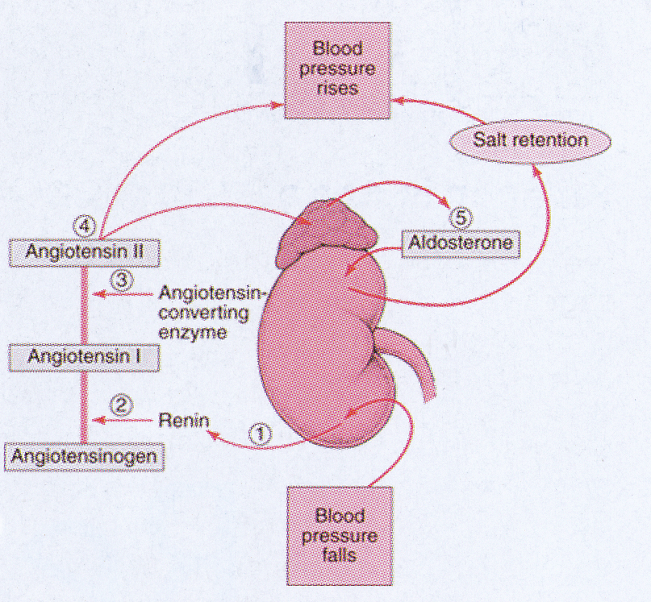
Systemic Hypertension - To Reduce BP to control albuminuria
RAAS – Renin Angiotensin Aldosterone System

Slide 12
ACE-Inhibitors (catopril, enalapril, benazepril, ramipril)
↓ glomerular capillary pressure (vasodilate efferent arterioles) by ↓ angiotensin II concentrations
↓ risk of doubling serum Cr and development of ESRD
↓ risk of progression from micro- to macro-albuminuria by 55%
↑ rate of regression from micro- to normo-albuminuria by > 3-fold
Strongest clinical outcomes in pts with Type I diabetes with albuminuria or proteinuria
Doses:
Captopril 25 mg tid
Ramipril 2.5 mg daily
Enalapril 5 mg daily
Benazepril 10 mg daily
Adverse Effects:
Acute ↑ SCr
Cough
Angioedema

Slide 13
Angiotensin II Receptor Blockers (losartan, irbesartan, valsartan)
↓ glomerular capillary pressure (vasodilate efferent arterioles) by blocking AT₁ receptors
↓ risk of doubling serum Cr and development of ESRD
↓ risk of progression from micro- to macro-albuminuria by 55%
Significant clinical outcomes in pts with Type II diabetes with albuminuria or proteinuria
Doses:
Candesartan 8 mg daily
Valsartan 80 mg daily
Losartan 50 mg daily
Irbesartan 150 mg daily
Telmisartan 20 mg daily
Adverse Effects:
xxxxxx
xxxxxx
xxxxxx
xxxxxx

Slide 14
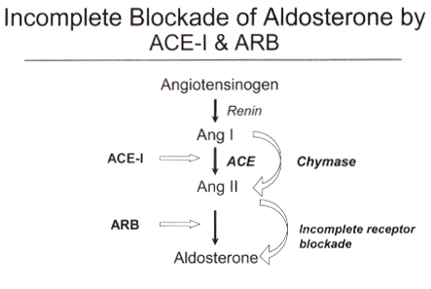
ACE-Inhibitors (catopril, enalapril, benazepril, ramipril)
Angiotensin II Receptor Blockers (losartan, irbesartan, valsartan)

Slide 15
Ca Channel Blockers – non-dihydropyridines (diltiazem, verapamil)
DHCCB class (amlodipine, felodipine) cause significant dilation at the afferent arteriole resulting in loss of renal autoregulation … ↑ intraglomerular capillary pressure & may ↑ proteinuria
↓ glomerular capillary pressure
↓ proteinuria
Prevent mesangial expansion and renal scarring (cytoprotective/antiproliferative)
Used in add-on therapy

Slide 16
Diuretics (HCTZ)
In pts with microalbuminuria, addition of HCTZ is not effective for Stage 4 to 5 … use loop diuretics instead
CONCLUSION: Reasonable adjunctive therapy to ACEi or ARB for reduction in albuminuria in patients with reasonably well preserved renal function (GFR >30ml/min)
Beta-Blockers
No Data on reducing proteinuria
Add on for BP control

Slide 17
COMBINATION THERAPY
ACEi + ARB combo:
Doubling the efficacy of the TX but with a lot of complications
Combo of ACEi plus ARB therapy is NOT recommended
Direct Renin Inhibitor (DRI) + ARB combo:
DRI: aliskiren (Tekturna®)
Black Box Warning: fetal/neonatal morbidity/mortality during pregnancy
Unlabeled use for Tx of persistent proteinuria in pts with Type II DM, HTN & proteinuria
CONTRAINDICATED with ACEi or ARB due to risk of renal impairment, HTN & hyperkalemia

Slide 18
Review of Systems Affected by CKD
Cardiovascular:
Na retention … volume expansion … ↑ edema … ↑ load of heart … LVH
Anemia … ↓ oxygen delivery … high cardiac output state … LVH
Hematologic:
Anemia (normocytic /normochromic), platelet dysfunction, ↑ risk of bleeding
Endocrine:
↓ insulin metabolism, lipid abnormalities, thyroid dysfunction
Dermatologic:
Dry, flaky, itchy skin
Gastrointestinal
Nausea, vomiting, altered tastes, anorexia, GI bleedings
Immunologic:
↑ risk of infection, impaired cell mediated immunity
Musculoskeletal
Renal osteodystrophy, muscle weakness
Nervous system:
Leg cramps, peripheral neuropathy, asterixis, uremic encephalopathy, seizures

Slide 19
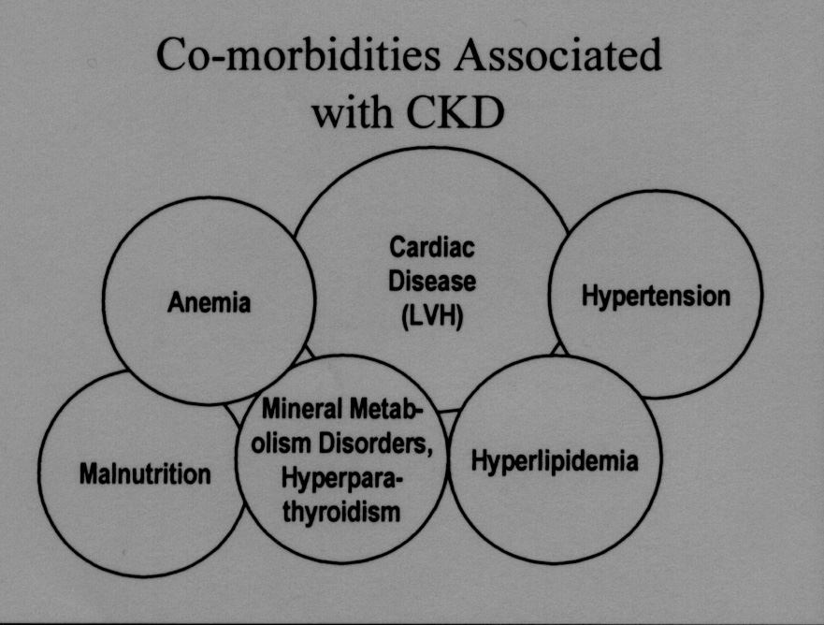

Slide 20
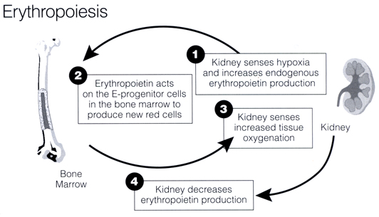
Anemia of CKD
Pathophysiology
1º Cause: ↓ endogenous production of erythropoietin by the kidney … Anemia (Sx of hypoxia, ↓Hgb/Hct, ↓ reticulocyte ct, RBC indices : normocytic, normochromic)
Others: blood loss, Fe deficiency, ↓ RBC survival due to uremic toxins, blood retention in the dialyzer

Slide 21
Clinical signs & symptoms:
Pallor, fatigue, anorexia, cold extremities
Morbidity & Mortality associated with anemia of CKD
Left ventricular hypertrophy (LVH) – Congestive heart failure (CHF)
Guidelines:
Subject | KDIGO/ KDOQI Guidelines
Definition of anemia by Hgb | Hgb <13.5 g/dl men Hgb <12.0g/dl women
Target Hgb | FDA species that ESA dosing should be reduced or interrupted if Hb level exceeds 11g/dl - but treatment should be individualized (consider risks vs. benefit) – Black BOX Warning
Target iron status | Transferrin Saturation Level (TSAT) lower limit: 30%
ESA: erythropoiesis-stimulating agents
TSAT: percent ratio of serum iron and total iron-binding capacity of transferrin

Slide 22
Pharmacotherapy:
Erythropoietin production becomes impaired when CrCl < 60 ml/min
ESA Treatment
Black-Box Warning:
With target Hgb > 11 … risk of death due to serious cardiac events & stroke
Use lowest ESA dose to avoid need for RBC transfusion (Hgb < 7) due to risk of infection
Consider initiating ESAs when Hgb < 10 g/dl
Hgb Scale for ESA Treatment (g/dl):
………….…..… 7 …..……........…. 10 …………….....… 11 …..................... 12 ………...………13.5
ESA Tx initiation ESA TX Stop Anemia (F) Anemia (M)
Blood transfusion

Slide 23
ESA Tx – Monitoring based on guidelines
H/H every 2-4 wks following initiation ESA Tx … every 3 mos when H/H is stable
If Hgb increase < 1 g/dl after 2-4 wks … ↑ weekly dose by 50%
Hgb > 11 g/dl, discontinue until Hgb < 10 g/dl
Dose adjustment no more often than every 2-4 wks
Check BP at least once a week and adjust anti-hypertensive agents
ESA Tx – Causes for inadequate erythropoietin response
Fe deficiency
Infection/inflammation
Chronic bone loss
Osteitis fibrosa
Aluminum toxicity
Folate/B12 deficiency
Hemolysis
Fe homeostasis is perturbed by CKD:
Uremia (BUN test) leads to GI bleeding by CKD … Fe loss
Alteration of macrophage to release Fe to tranferrin
Low level of transferrin

Slide 24
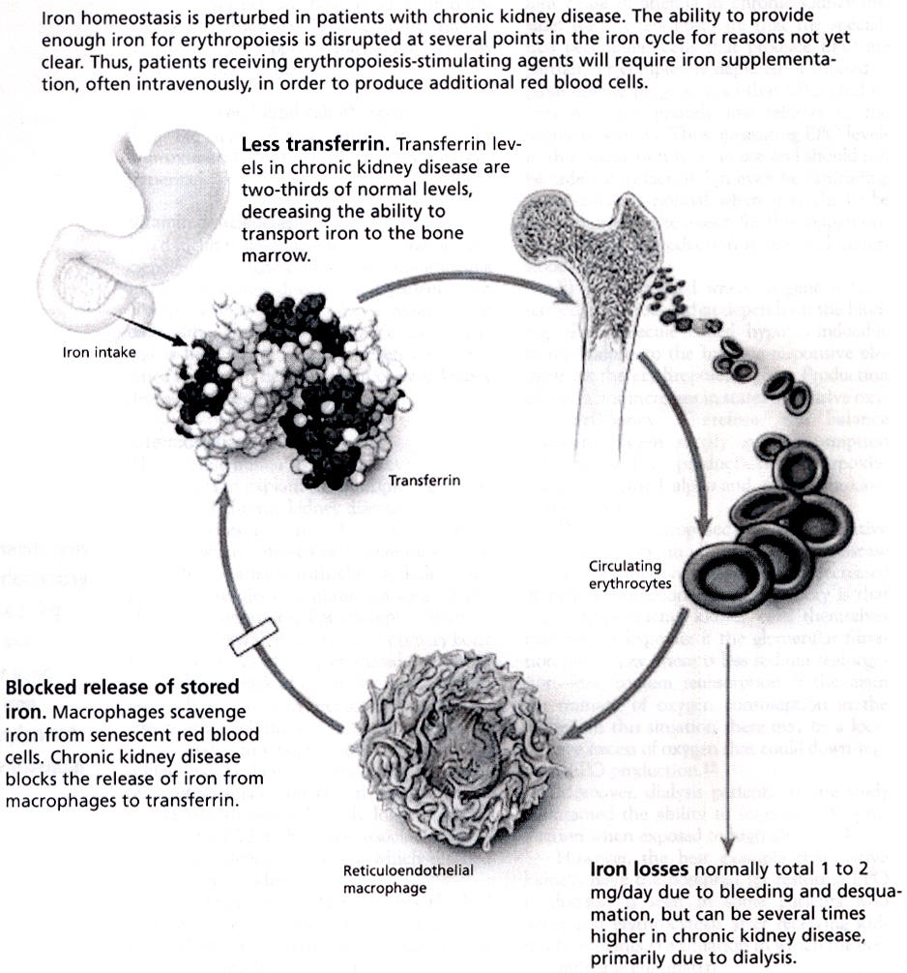
Transferrin is a molecule that binds iron and serves as a shuttle from storage location to RBC

Slide 25
Iron Supplementation Therapy
Diagnosis of Fe deficiency anemia:
Total transferrin saturation (TSAT) < 30% … Total Fe binding capacity (TIBC) of transferrin↑
Mean corpuscular volume (MCV) ↓
Serum Fe (Fe available for Hgb synthesis) ↓
Serum ferritin < 100 ng/ml – Fe stores & indirect measure of Fe sufficiency
TSAT = (Serum Fe / TIBC) x 100
TSAT: % iron immediately available for erythropoiesis
Why IV iron?
Efficacy of Fe PO variable in hemodialysis pts
Malabsorption
Compliance issue

Slide 26
IV Iron Products – Target Dose: 1 g
Generic Name (Trade Name) | Dose range/ Frequency | Comments
Iron dextran (InFeD®, Dexferrum®) | 10 doses | Risk of anaphylaxis, test dose required, Possible ADE: fevers, myalgias, flushing, iron overload, infection
Iron sucrose product (Venofer ®) | 10 doses | Better safety profile than iron dextran, Possible ADE: HOTN, iron overload, infection
Sodium ferric gluconate complex (Ferrlecit ®) | 8 doses | Better safety profile than iron dextran Possible ADE: HOTN, iron overload, infection
Ferumoxytol (Feraheme®) | 510mg IV x 1 dose, followed by 510mg IV 3-8days later | Better safety profile than iron dextran Possible ADE: HOTN, iron overload, infection
Can we give 1 g IV in one dose?
Monitor TSAT and ferritin in 1 month for parenteral IV therapy

Slide 27
PO Iron Products
Target Dose: 200 mg of elemental Fe daily in 2-3 divided doses
Iron salt | Dose (mg) | Elemental iron content (mg) | Dosage
Ferrous sulfate | 324 | 65 | One tablet 3x/day
Ferrous gluconate | 325 | 38 | Two tablets 3x/day
Chromagen (ferrous fumarate) |  | 156 | One tablet daily
Polysaccharide iron complex (Niferex-150 Forte®) | 150 | 150 | One tablet daily
Adverse effects: GI irritation, constipation
Enteric coated preparation should be avoided b/c duodenum is where max Fe absorption occurs
Drug/food interactions: fluoroquinolone, doxycline … dairy products
Monitor Ferritin & TSAT every month initially then q 3 mos once stable

Slide 28
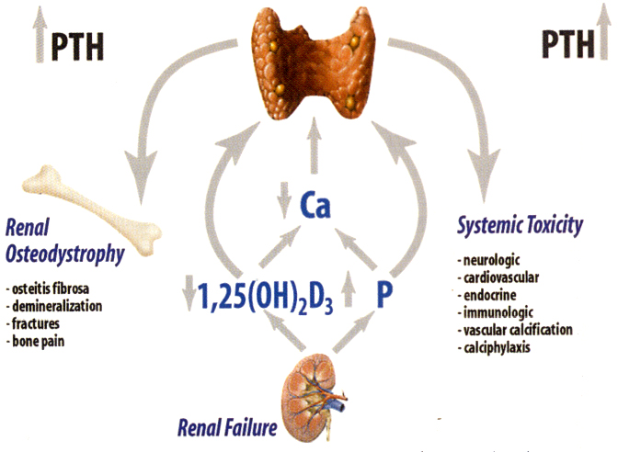
Secondary Hyperparathyroidism (PTH, Calcium, Vit D feedback)
Pathophysiology of 2º Hyperthyroidism

Slide 29
Pathophysiology of 2º Hyperthyroidism – Two main events:
- ↓ phosphorus elimination by kidneys … Serum Hyperphosphatemia … Hypocalcemia … 2º HyperPTH
- ↓ active vit D3 … Hypocalcemia … 2º HyperPTH
Complications of 2º PTH – Calcification & Renal Osteodystrophy
Vascular & Soft Tissue Calcification (precipitation of Ca and Phos outside of bone)
- CV: myocardium, coronary arteries, cardiac valve … CHF, arrythmias, ishcemic heart disease
Non-Cardiac: lungs (pulm fibrosis, hypertension), abdominal aorta, interstitium of kidneys
Renal Osteodystrophy
- ↑ PTH levels … Osteitis fibrosa (high turnover bone) … ↑ mobilization Ca from bone … mineralization of tissue
- ↓ PTH levels … Osteomalacia (low turnover bone) … impaired mineralization of bone … mineralization shunted to soft tissue instead of bone
- Mixed osteodytrophy
Bone Remodeling (balance between osteoclastic & osteoblastic activities) is necessary for healthy bone structure

Slide 30
Prevention & Tx of 2º HPT
Goals:
Serum Phosphorus 2.5 - 5.0 mg/dl … Hyper
Serum Calcium 8.4 - 9.5 mg/dl … Hypo
PTH for Stage 5 CKD 150 - 300 pg/ml … Hyper
Monitor q 4 wks initially then q 3-6 mos therafter
High levels of PTH is needed to regulate normal bone turnover in dialysis population b/c of downregulated PTH receptors
Based on Corrected Ca Level in pts:
Corrected Ca = Measured Total Ca + 0.8 x (4.0 – serum albumin)
(mg/dl) (mg/dl) (g/dl)

Slide 31
Pharmacotherapy of 2º PTH
Non-Pharmacologic Measures:
- Restrict dietary phosphorus intake (canned foods, sea foods, dairy products, dark colored Coke/Pepsi)
Pharmacologic Approach:
- Phosphate binders to correct hyperphosphatemia
- Vit D analog / Calcimimetics to ↓ PTH
Phosphate Binders:
- Binds exogenous phosphorus from gut and endogenous from recirculation
- Must be taken with meals to optimize binding effects b/c with empty stomach … drugs as Ca supplements
- Phosphate binder is the ONLY Tx for hyper phosphatemia b/c phosphorus is not significant removed by dialysis

Slide 32
Phosphorus Binding Products
Ca Carbonate high risk of hypercalcemia
Ca acetate lower risk of hypercalcemia than carbonate (1/2 amt of Ca)
Most commonly used – Phos > 4.5
Aluminum prod. Risk of aluminum toxicity, osteomalacia, encephalopathy
Reserved for short term (3-5days) in cases of severe hyperphosphatemia (Phos> 11mg/dl)
Polymer based Maximal phosphate binding at pH7
Can cause metabolic acidosis
Lanthanum Binding occurs across a wide pH range
Chewable formulation
Expensive
Ca binder MUST be taken with foods - otherwise, as Ca supplements

Slide 33
Vitamin D Analogs
Direct acting on Vit D receptors on parathyroid … inhibit PTH secretion
Promote GI absorption of Ca … prevents skeletal complications
Agent | Dose | Adverse effects
Calcitriol (1, 25-dihydroxyvitamin D3) | Rocaltrol®:0.25-2 mcg po daily or 3 times a week Calcijex®: 1-5 mcg IV tiw | Hypercalcemia manifested by constipation and nausea
Paricalcitol (19-nor-1-α-25-hydroxyvitamin D2); Zemplar® | Initial dose: 0.04 mcg/kg IV 3 times a week; max dose 0.24mcg/kg (2.5-15mcg IV 3 times a week) Also available po | May produce less hypercalcemia than other Vit D analogs
Doxercalciferol (1-α-hydroxyvitamin D2); Hectoral® | 2-8 mcg IV 3 times a week Also available po | Hypercalcemia manifested by constipation and nausea
PO for non-dialysis pts
IV for dialysis pts tid … in compliance with dialysis frequency of 3x/wk

Slide 34
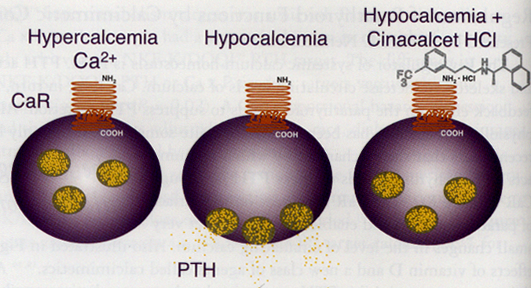
Calcimimetic Agents
Activate Ca –sensing receptors on PT glands … regulate PTH secretion
When activated, receptors become more sensitive to extracellullar C which binds & inhibits PTH secretion
Sensipar® (cinacalcet) - PO
NO PTH released under hypoCa when drug bound to receptors
Only approved in dialysis pts in Stage 5 CKD (150-300 pg/ml)
Do Not start Tx if serum Ca < 8.4 mg/dl … due to hypoCa … seizure, tetany, convulsion, cramping
Add on Tx with Vit D analogs
Review Summary Approach to the Prevention & Management of 2º HPT
GFR < 50-60 ml/min

Slide 35
Hyperkalemia
Renal K excretion ↓ … redistribution of K into extracellular fluid due to metabolic acidosis
Tx typically initiated when K >5.5 mEq/L … EKG changes typically occurs when K > 7 mEq/L
Tx of HyperKalemia
Regular Insulin … IV ± 25-50 g of glucose
Insulin shift extracellular K back into cell
Insulin stimulates K uptake by skeletal muscle & hepatic cells
dextrose given to avoid hypoglycemia only
Na Polystyrene Sulfonate (PO or enema)
Exchange Na for K in GI tract … direct effect on K level
Use as maintenance Tx
Ca Gluconate or Ca Chloride (IV)
Only indicated when EKG changes are present … Emergency with one time dose for acute Tx
Dialysis
Low K dialysate … Hemodialysis most effective at removing K
Short-time Tx for 1 – 2 days

Slide 36
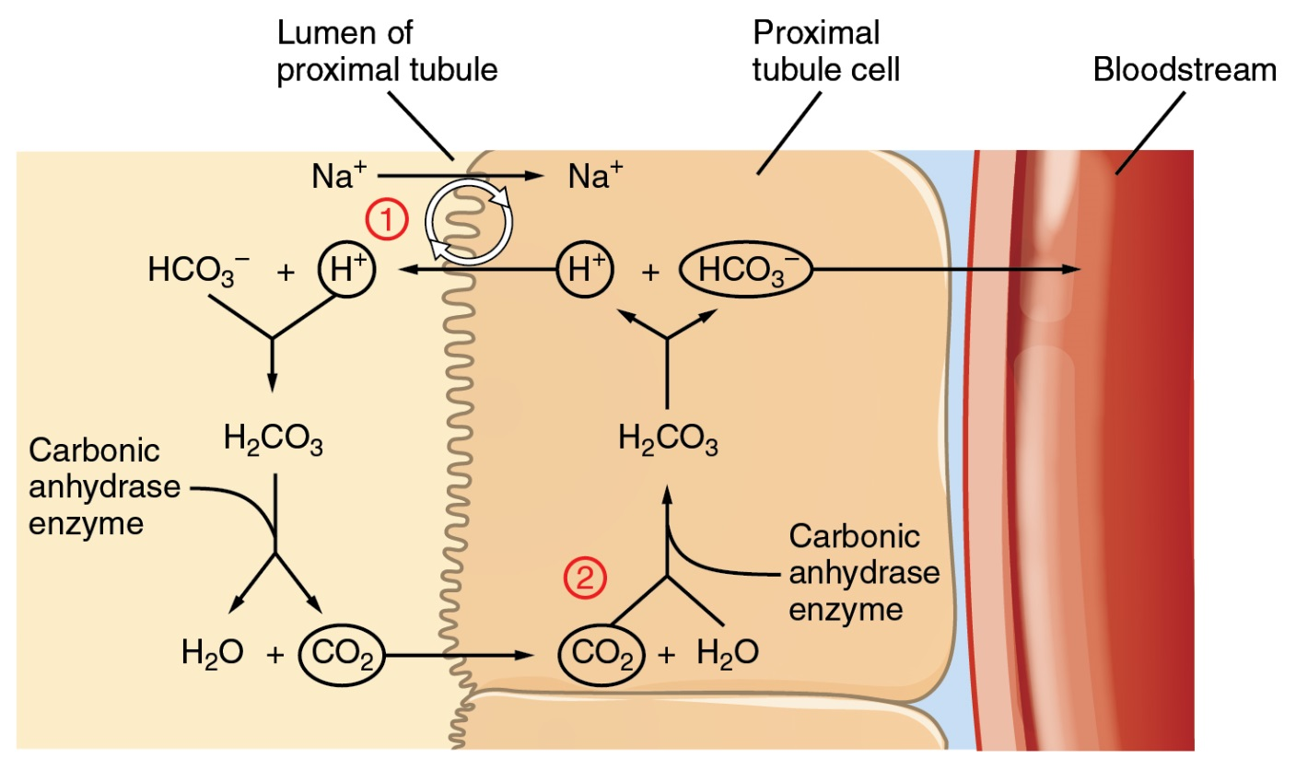
Metabolic Acidosis
Principal role of the kidneys in maintaining acid-base homeostasis is to regulate the concentration of bicarbonate in the blood
Tubular cells are not permeable to bicarbonate; thus, bicarbonate is conserved rather than reabsorbed
In the diseased kidneys, there is a decrease in hydrogen ion production and subsequent reduced bicarb absorption
Buffering excess H+ ions may be accomplished by the release of calcium and phosphorus from bone, thereby worsening bone disease

Slide 37
Tx of Metabolic Acidosis
Bicarbonate replacement when bicarb level < 20
Na Bicarbonate tablets
Bicitra oral liquid (Na citrate + Citric acid)
Doses: bid or tid

Slide 38
Vitamin Replacement
More commonly used for dialysis pts
Water-soluble vitamins: B complex & C
Fat-soluble vitamins: ADEK … not dialyzable … AVOID in pts on dialysis
Nephrocap
Renal Multivitamin Formula
Nephrovite

